Slide 1
FACIAL EXPRESSION RECOGNITION
Lavish Lodha (16BCE097)
Shrey Malvi (16BCE099)
Guided By: Prof. Parita Oza

Slide 2
Introduction
Facial Expression recognition performed a 7-way forced choice between the following emotion categories: Happiness, sadness, surprise, disgust, fear, anger, neutral.
Computer systems with FER have a wide range of applications in basic and applied research areas, including man-machine communication, security, law enforcement, psychiatry, education, and telecommunication

Slide 3
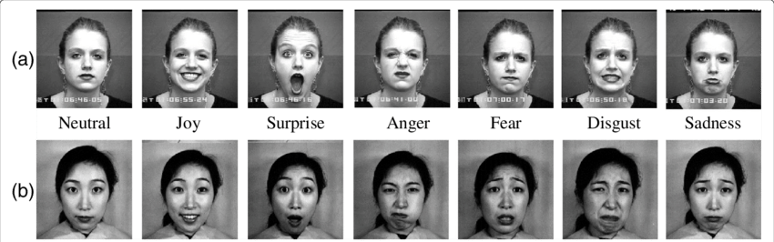
Datasets
CK+(Cohn and Kanade’s DFAT-504 dataset):
This dataset consists of 100 university students ranging in age from 18 to 30 years. 65% were female, 15% were African-American, and 3% were Asian or Latino.
Image sequences from neutral to target display were digitized into 640 by 480 pixel arrays with 8-bit precision for grayscale values.

Slide 4
Steps
Face Detection
Feature Extraction
Training Model
Viola Jones Algorithm
HOG feature Extraction
SVM or ANN
Recognition
ML models

Slide 5
Methods
HOG+SVM
An Image Processing based approach for the extraction and Machine Learning algorithm for the classification.
Deep CNNs
A Deep Learning based approach by directly feeding the dataset onto the Convolutional Neural Network for recognition.

Slide 6
FACIAL DETECTION
Viola Jones Algorithm
Haar Features -> Feature Extraction
Integral Image -> Finding the sum of pixels
Adaboost -> Choosing the best features (reducing features)
Cascading -> Optimizing the computational efficiency

Slide 7
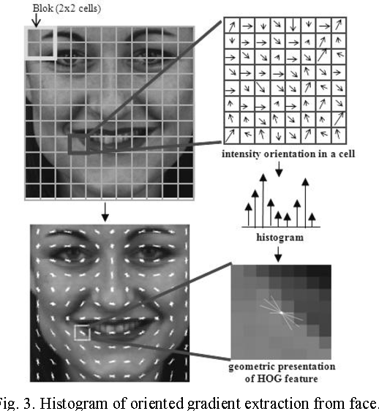
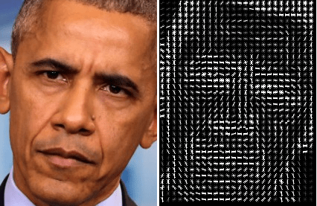
Feature Extraction

Slide 8
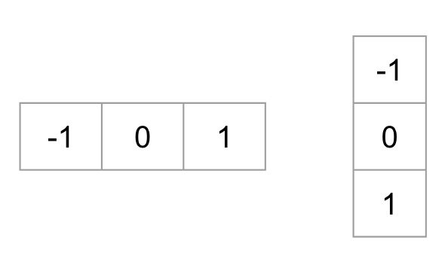

FEATURE EXTRACTION
Histogram of Gradients (HOG)
Converting input image to vector of length n.
Magnitude ->
Direction ->
Gx
Gy

Slide 9
FEATURE EXTRACTION
Calculating histogram of all calculated magnitude.
Normalizing the histogram.

Slide 10
Machine Learning
Logistic Regression
SVM
Deep CNNs

